Slide 1
Cyclistic Bike-Share
Case Study
Prepared by: Martin Guevara
Date: 02-12-2025

Slide 2
The Scenario
Cyclistic is a bike-share program based in Chicago with a fleet of more than 5,800 bicycles and 600 docking stations
They offer flexible pricing plans from single-ride passes, full-day passes, and annual memberships
Customers who purchase single-ride and full-day passes are referred to as casual riders, while those who purchase a membership are Cyclistic members

Slide 3
The Problem
How do we convert casual riders into members?

Slide 4
The Agenda
1
Questions
2
Dataset of Choice
3
Analysis
4
Observations
5
Recommendations
6
Recap
7
Conclusion

Slide 5



Questions
How do members use cycles differently from a casual rider?
What are the criteria that define both user types?
What are issues that keep a casual rider from subscribing?

Slide 6
Datasets of Choice
Google provided the datasets for this case study here under the following license
I will be using data from Q1 of 2019 and 2020. Both data sets contain over 300,000 observations of historical rider data (e.g. bike ids,station names, ride length, coordinates)
Given the size of the dataset & relations between several fields, I will be using RStudio and Tableau to manipulate the data

Slide 7
Analysis
Trip Times
Distances
Trip Locations
Trip time can be a measure of a rider’s usage of a cycle
Variables used: day of week, user type, trip duration (in seconds), number of trips, starting time (hour)
Distance can show a rider’s travel patterns
Variables used: total distance (in m), user type, day of week
Observing where riders go can show their intent with the cycle
Variables used: station name, total number of trips, user type

Slide 8
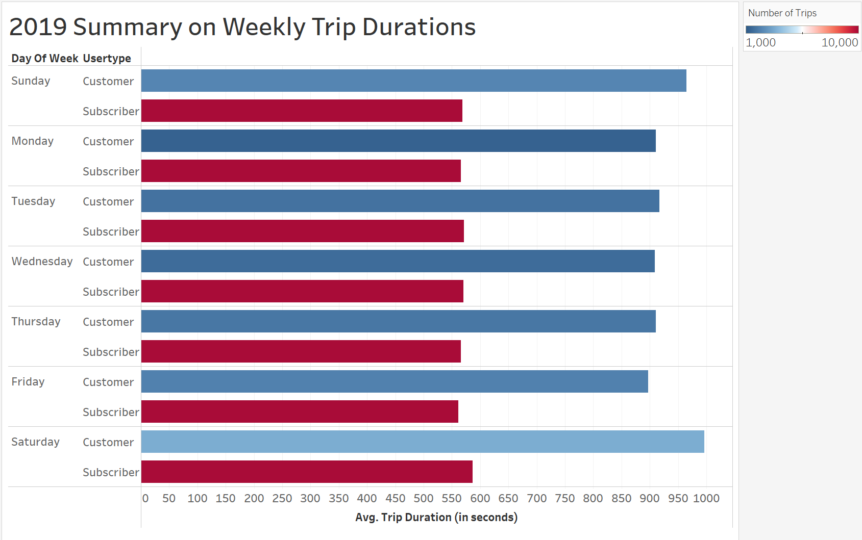
Trip Times
Customers on average, spent more (~400 seconds or 6.5 minutes) time on cycles than subscribers
Customers rarely book cycles but take their time with it when they do
Notes:
*see Appendix for 2020 plot on Tableau

Slide 9
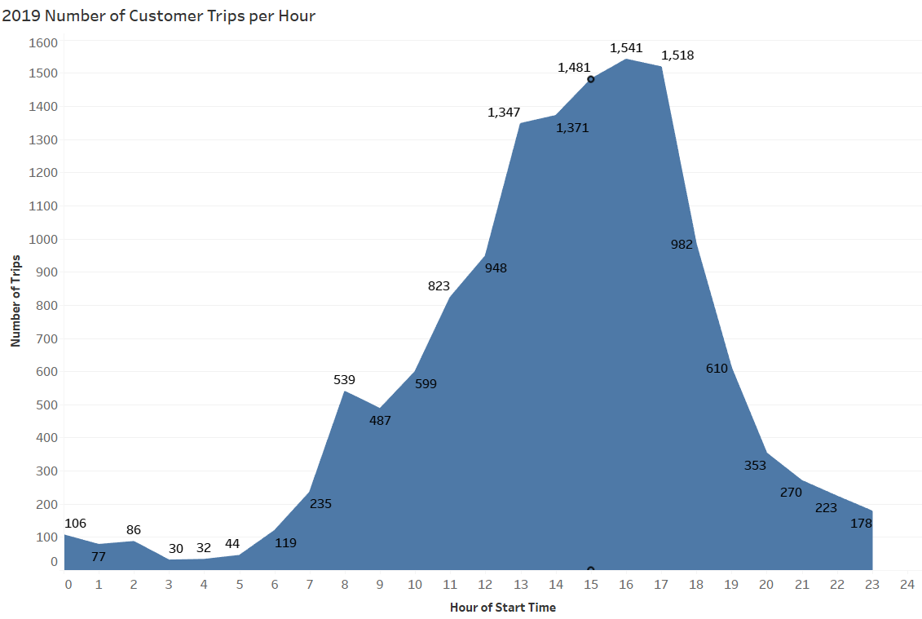
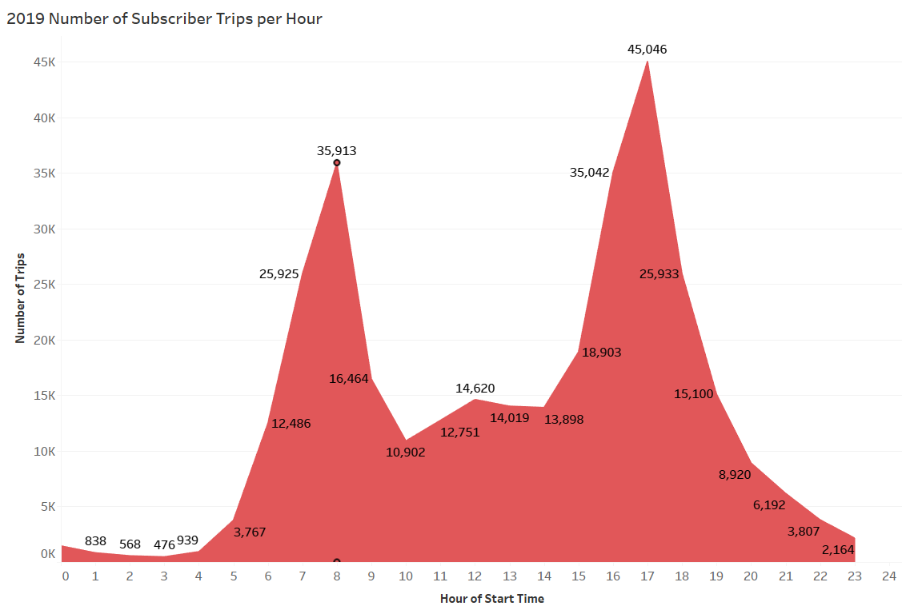
Trip Duration
Customers bookings (in blue) also peak in the afternoon, while subscriber bookings (in red) spike at 8am and 5pm respectively.
Notes:
*see Appendix for 2020 plot on Tableau

Slide 10
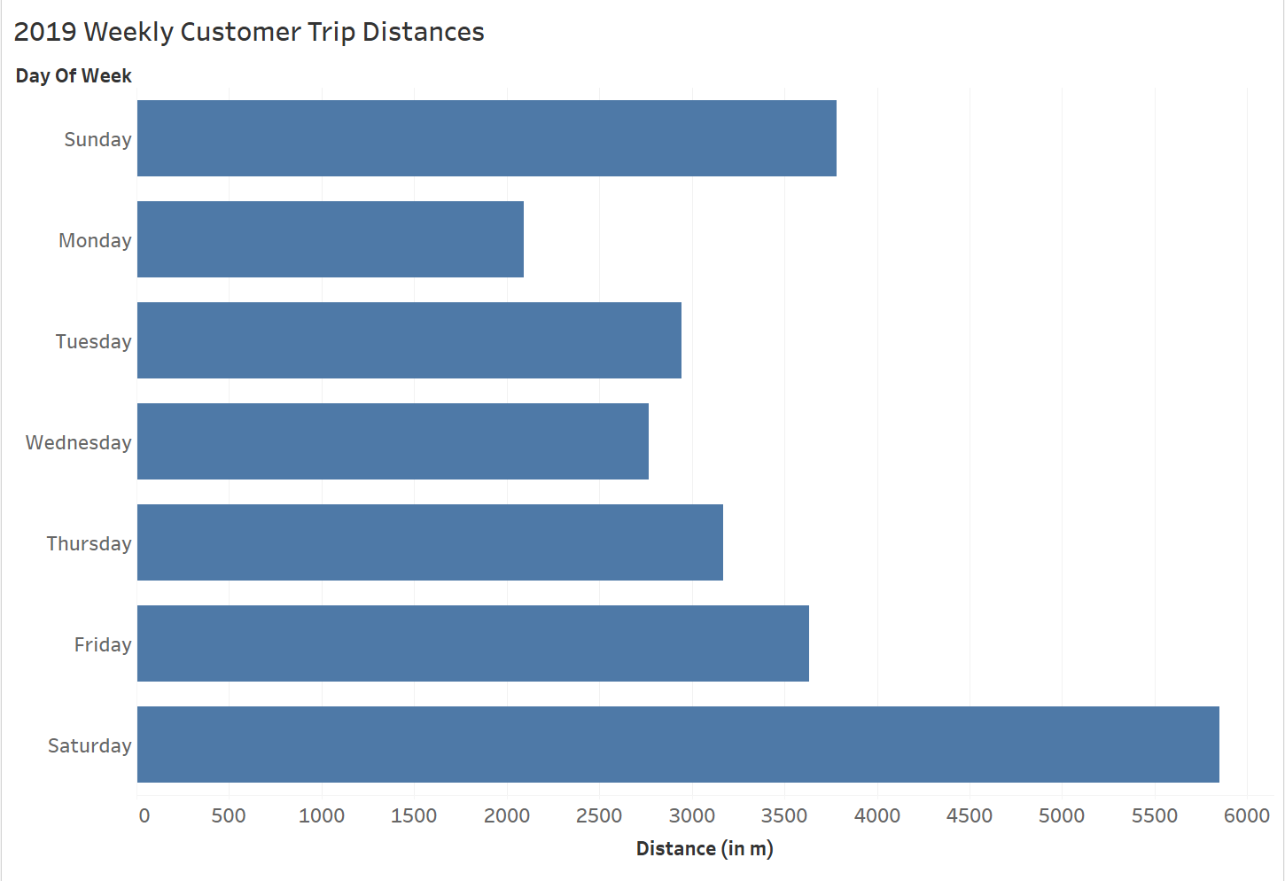
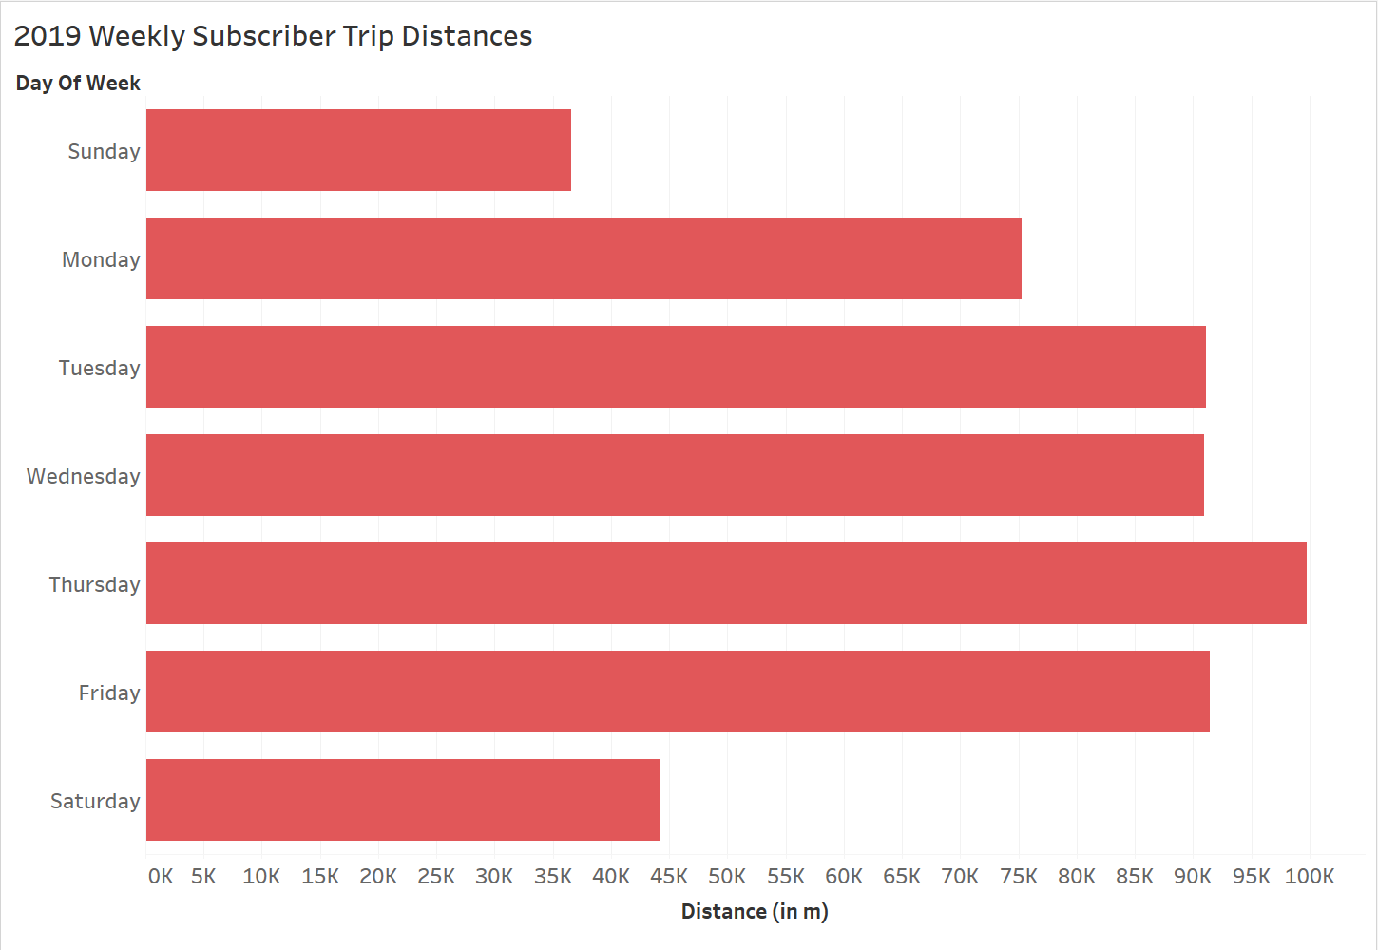
Distances
Based on the total distances covered, customers (in blue) traveled the most during weekends, and subscribers (in red) on weekdays
Customers use cycles on an as needed basis and subscribers use it routinely
Notes:
*see Appendix for 2020 plot on Tableau

Slide 11
Trip Locations
6 of the top 10 stations for customers are public areas (e.g. parks, aquariums, planetariums, theatres)
The top stations for subscribers are located within the city. (e.g. Clinton & Madison, Canal & Adams) Typically, these are addresses for offices and residences
Customers booked the most trips to public spaces and subscribers to private addresses
Notes:
*see Appendix for 2020 plot on Tableau

Slide 12
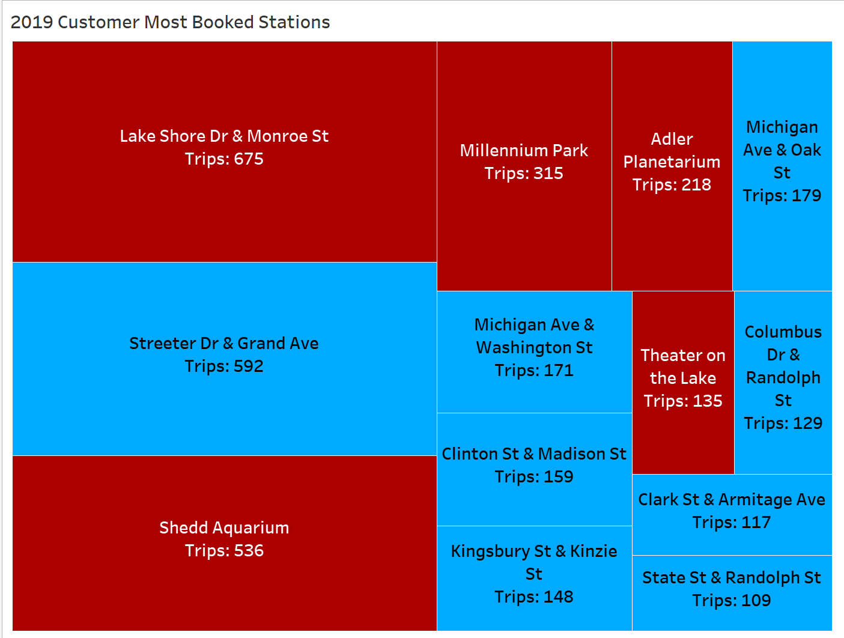
Notes:
*see Appendix for 2020 plot on Tableau

Slide 13
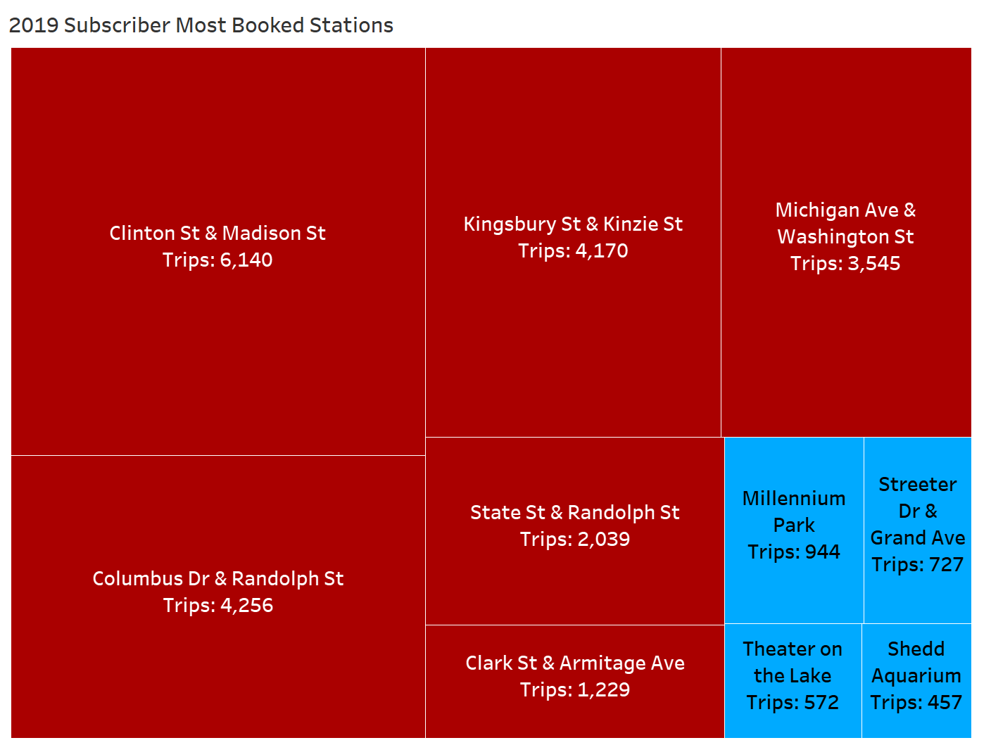
Notes:
*see Appendix for 2020 plot on Tableau

Slide 14
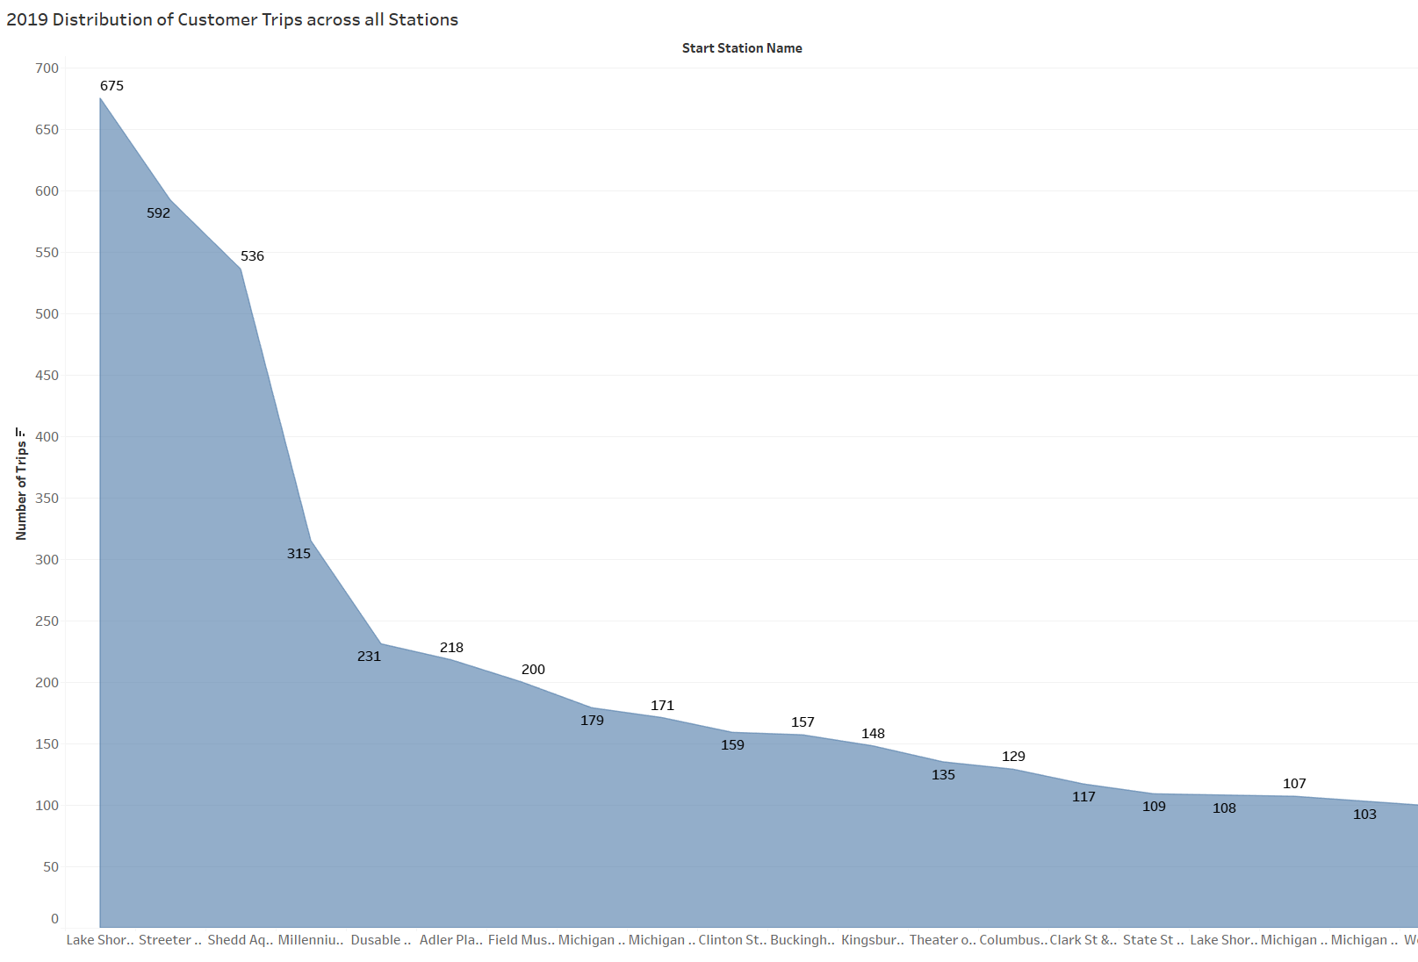
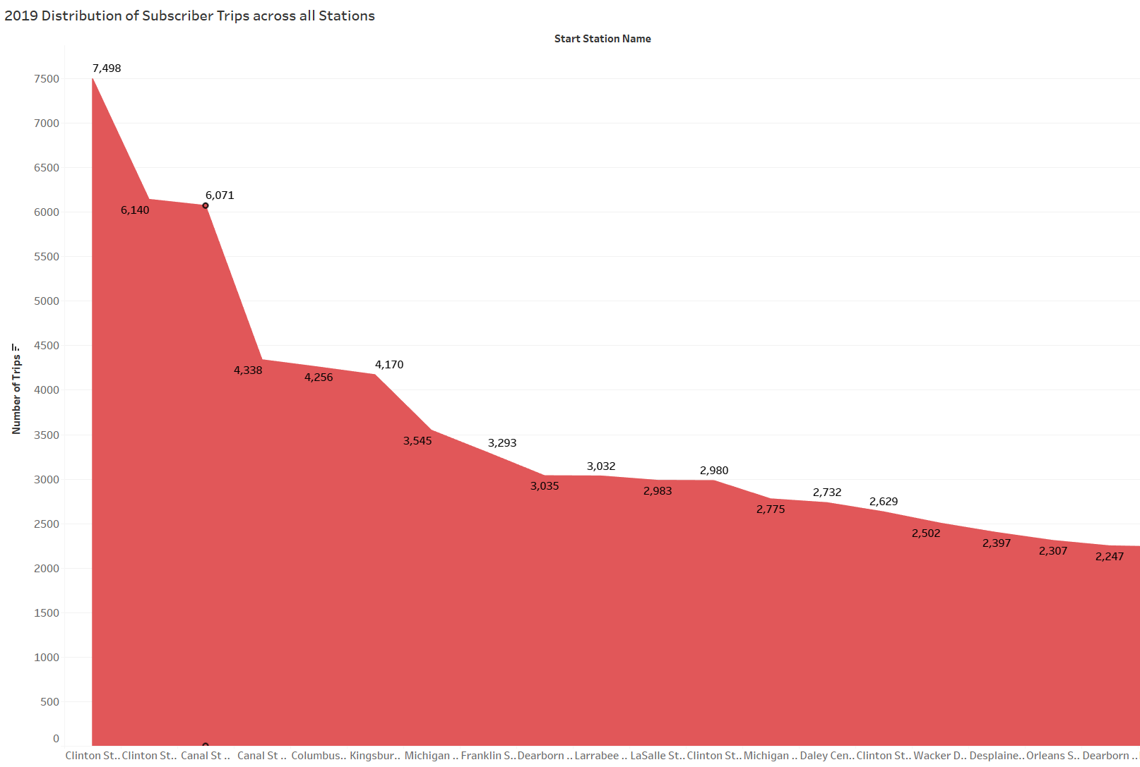
Trip Locations
The distribution of stations booked for customers (in blue) is skewed while the one for subscribers (in red) is more evenly spread, suggesting that customers making bookings at a limited number of stations
Notes:
*see Appendix for 2020 plot on Tableau

Slide 15
Observations
Notes:
*see Appendix for 2020 plot on Tableau

Slide 16

Customers
Subscribers
Spends more time on cycles
Book trips to public areas (e.g. parks, aquariums, planetariums, theatres)
Travel the most during weekends
Use cycles in the afternoons
Spends less time on cycles
Book trips to private areas (e.g. offices & residences)
Travel the most during weekdays
Use cycles in early mornings and late afternoons
Notes:
*see Appendix for 2020 plot on Tableau

Slide 17
Recommendations
Notes:
*see Appendix for 2020 plot on Tableau

Slide 18


Problems/Solutions
Members use Cyclistic because they need it. Appeal to the population’s need for transport
Increase presence in high traffic areas like universities and city centers by building new docking stations
Customers find Cyclistic at recreational spaces. Increase awareness in those environments
Extend program reach by implementing targeted marketing campaigns at recreational spaces like sporting arenas or theme parks
Subscribers make 10x more bookings than casual riders. Remind people of the reasons behind that volume
Change the messaging of current campaigns to highlight the ubiquity and convenience of Cyclistic cycles
Notes:
OBSERVATION: Members use Cyclistic because they need it. Most bookings are made during 8am and 5pm, which are typically the starting and ending hours for work or school. Similarly, most bookings occur within the city, suggesting that members often come from offices, residences, and other private addresses.
SOLUTION: Create need for the program by increasing presence in high traffic areas. Target places like universities, large suburban villages, or industrial sites for campaigns or even new docking stations to cater to the entire population’s transporting needs
OBSERVATION: Customers book a majority of their trips for recreational purposes. They travel the greatest distances over the weekend (Saturdays and Sundays), and frequent docking stations at public areas like parks, theatres, or aquariums.
SOLUTION: Increase awareness of the program by implementing campaigns at cultural sites like sporting arenas, city centers, or recreational parks to extend reach towards the casual rider demographic.
OBSERVATION: Customers spend a lot of time on cycles but don’t make bookings often. Meanwhile, subscribers on average, make 10x the number of bookings at any given day. This could be an issue in perception: a misalignment of how casual riders understand the program’s benefits.
SOLUTION: Highlight the program’s unique selling point as a ubiquitous and convenient way to commute. Casual riders only use Cyclistic as a way to explore, but they could be using it to get around in general. In other words, expand their use case for the program. Create niche campaigns that emphasize the widespread presence of Cyclistic (600 docking stations and counting) and the convenience of using one of their cycles (subscribers make as many as 45,000 bookings in an hour)

Slide 19
Recap
Longer average trip times
Bookings mostly made in the afternoon
Lack of use
Appeal to their transport needs
Build new docking stations at high traffic areas
How do we convert casual riders to members?
Favor recreational destinations
Most trips happen during the weekend
Launch marketing campaigns at recreational spaces
“Go where they are”
Remind them of what they’re missing out on
Sporadic usage of cycles
Limited number of stations booked
Emphasize Cyclistic’s USP in current campaigns
Notes:
*see Appendix for 2020 plot on Tableau

Slide 20
Appendix
Notes:
*see Appendix for 2020 plot on Tableau

Slide 21
Data Sources: https://divvy-tripdata.s3.amazonaws.com/index.html
Icons: https://thenounproject.com/
Tools Used: RStudio Desktop, Tableau, Figma
Notes:
*see Appendix for 2020 plot on Tableau

Slide 22
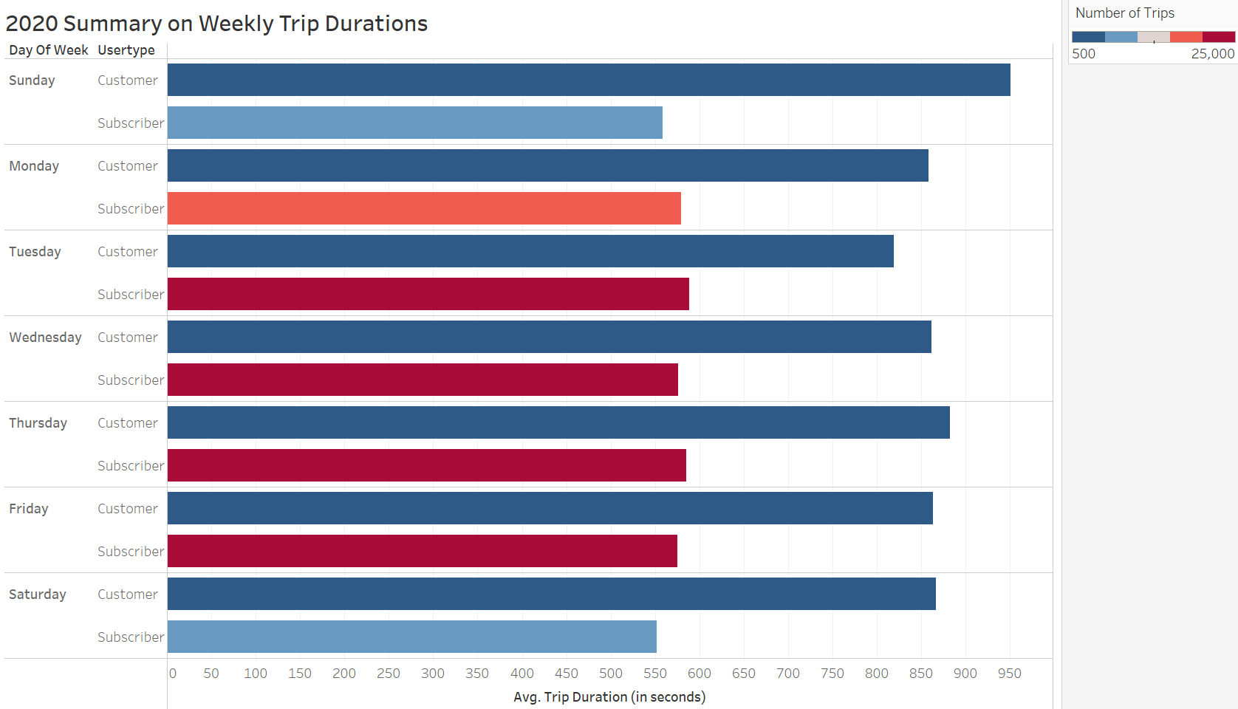
Notes:
Slide 8: 2020 Plot for Weekly Trip Durations

Slide 23
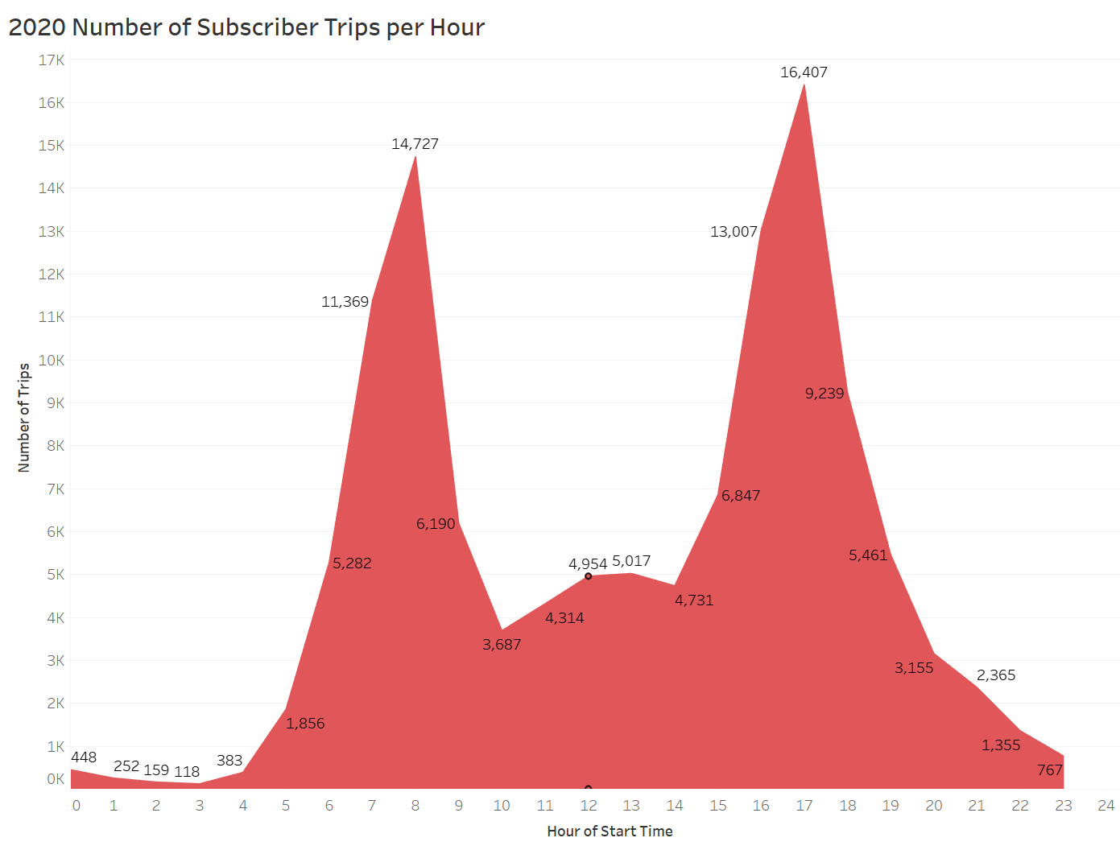
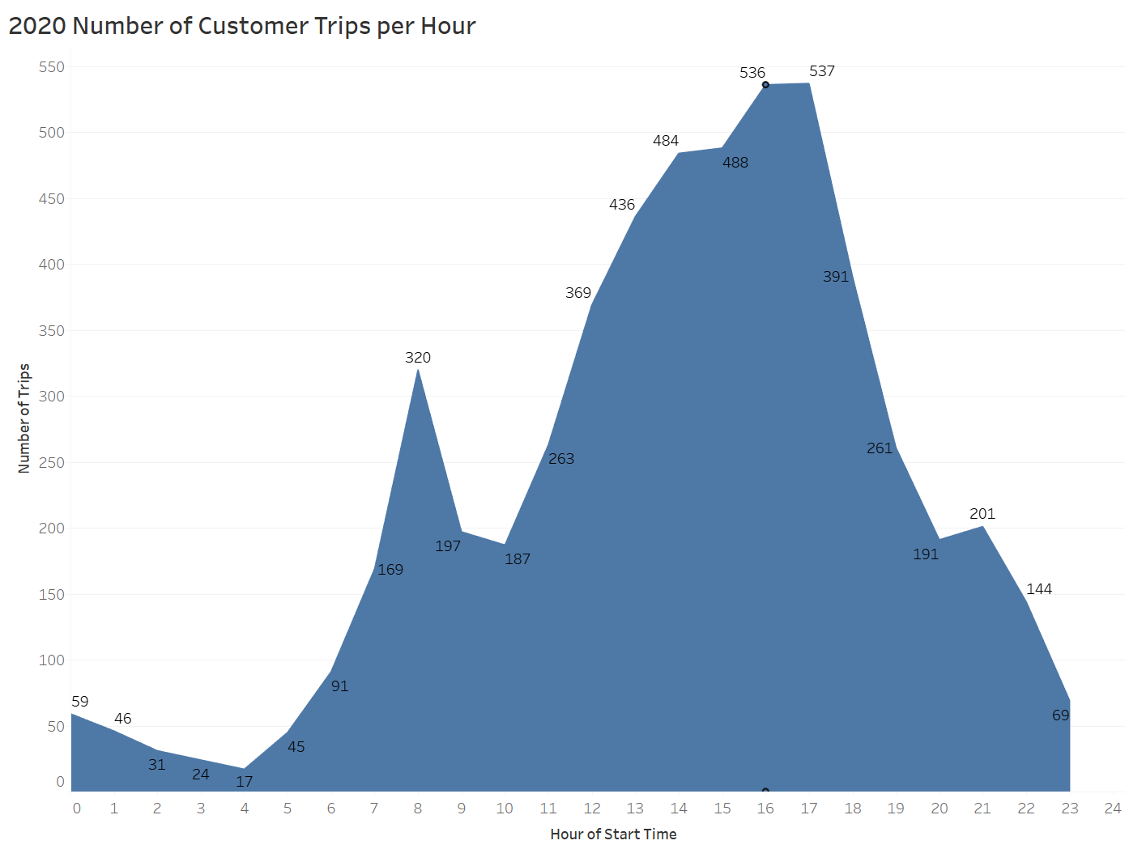
Notes:
Slide 9: 2020 Plot for Number of Subscriber Trips per Hour

Slide 24
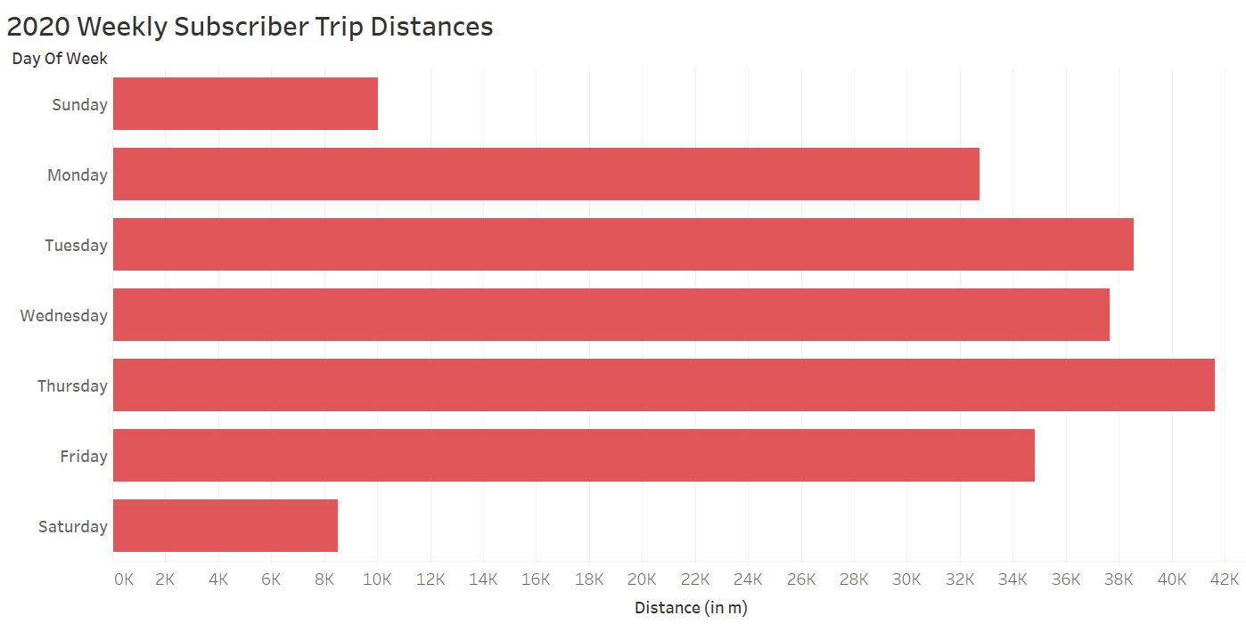
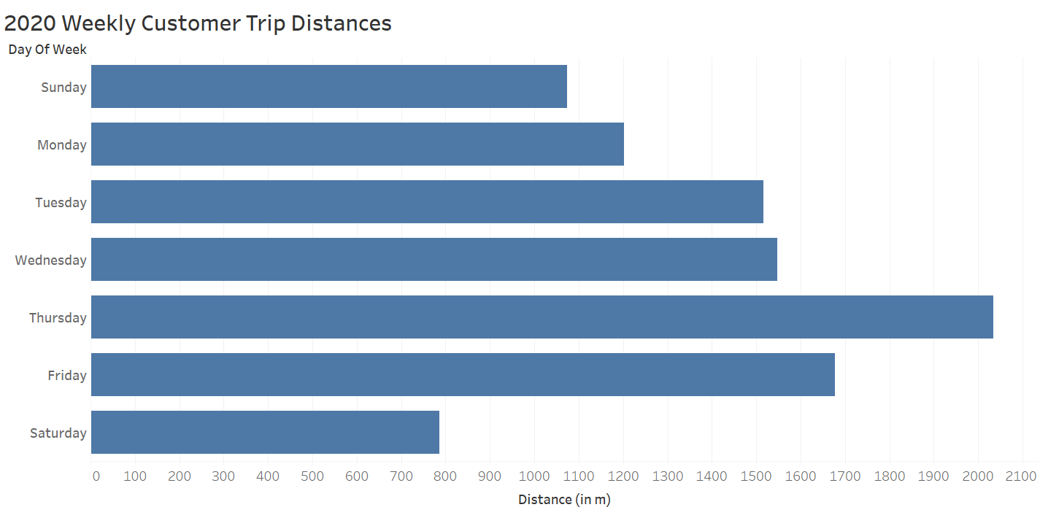
Notes:
Slide 10: 2020 Plot for Weekly Trip Distances

Slide 25
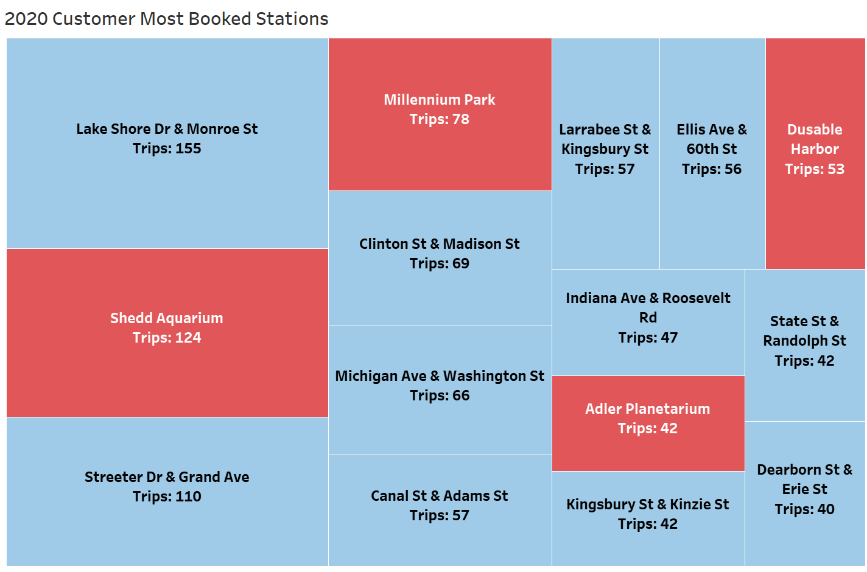
Notes:
Slide 12: 2020 Plot for Customer Most Booked Stations

Slide 26
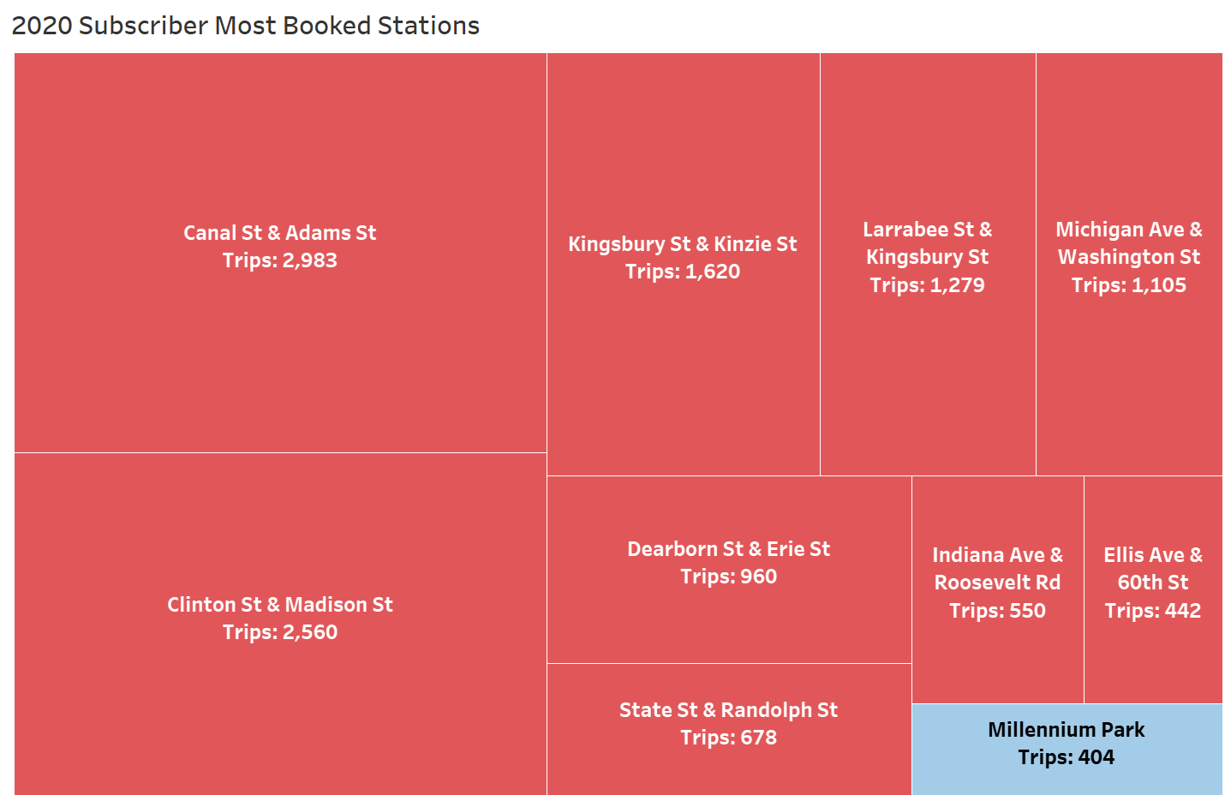
Notes:
Slide 13: 2020 Plot for Subscriber Most Booked Stations

Slide 27
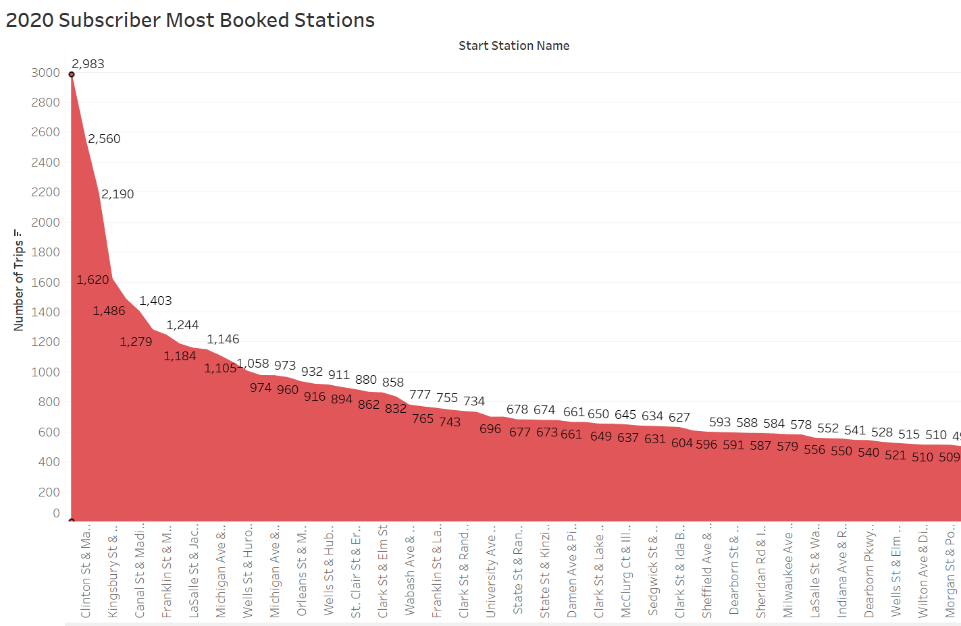
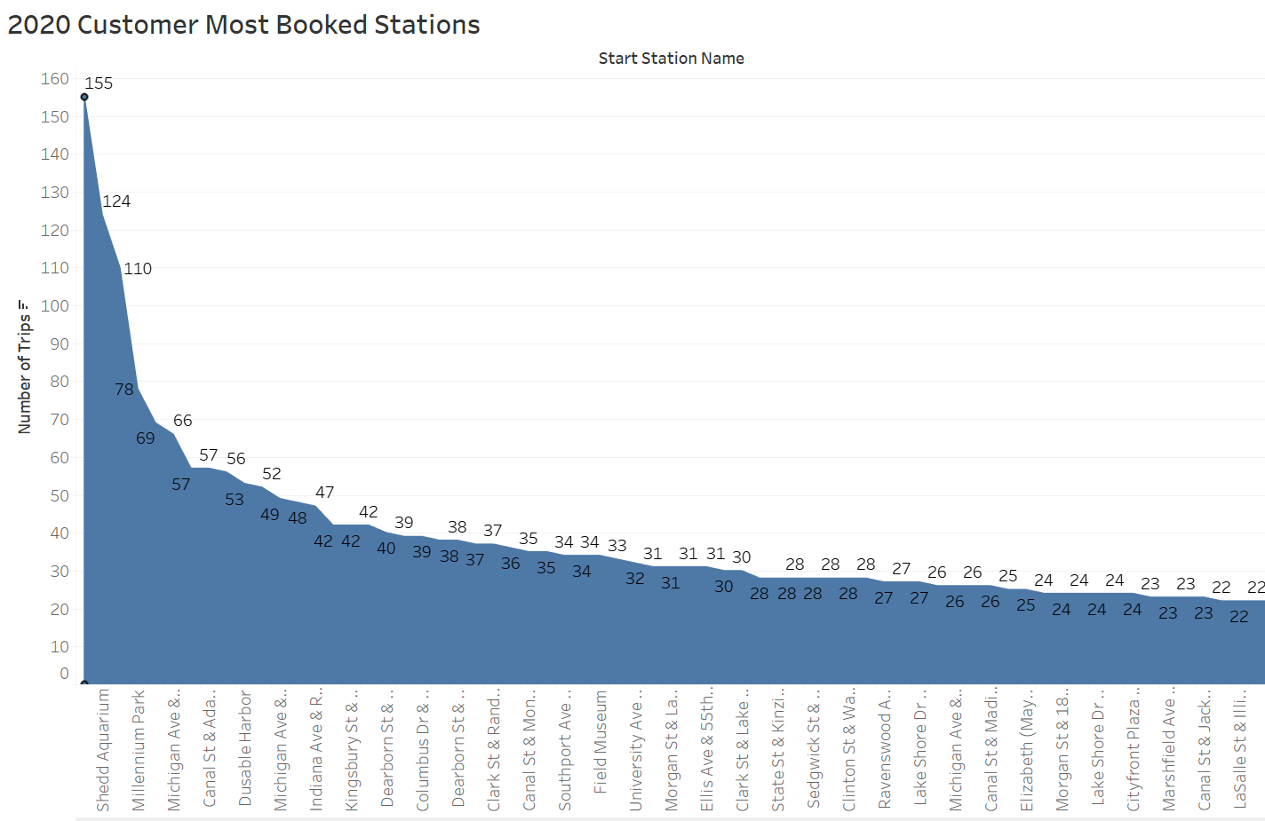
Notes:
Slide 14: 2020 Plot for Most Booked Stations

